Slide 1


The Search for Planet Forming Regions in Young Binaries
By: Mallory Vale
Mentor: Lisa Prato

Slide 2
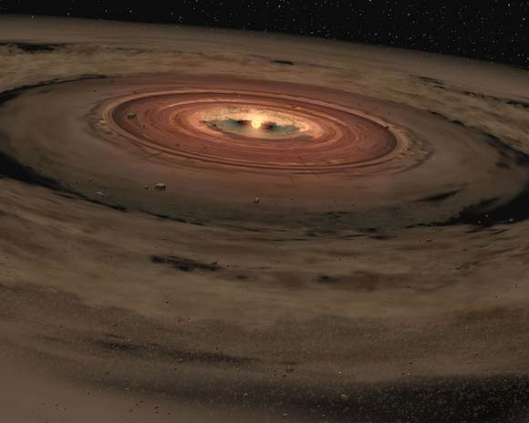
Outline
Introduction
Observations
Data
Analysis
Conclusion

Slide 3
Introduction
Big question: Are we alone?
How common are planetary systems?
How do they form?
Most stars are binaries, so can planets still form in binary systems?
What is the raw material that planets form from?
What is a Brackett gamma emission, and its Importance?
What is K-L color excess, and its importance?

Slide 4
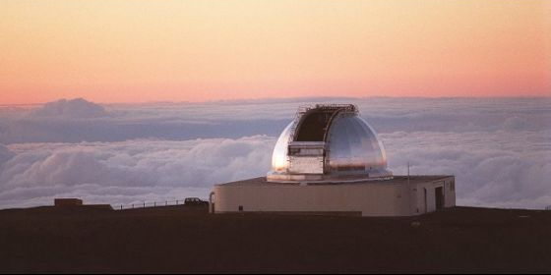
Observations
NASA Infrared Telescope Facility
Data taken on the nights of May 9 and 10, 1999 UT.

Slide 5
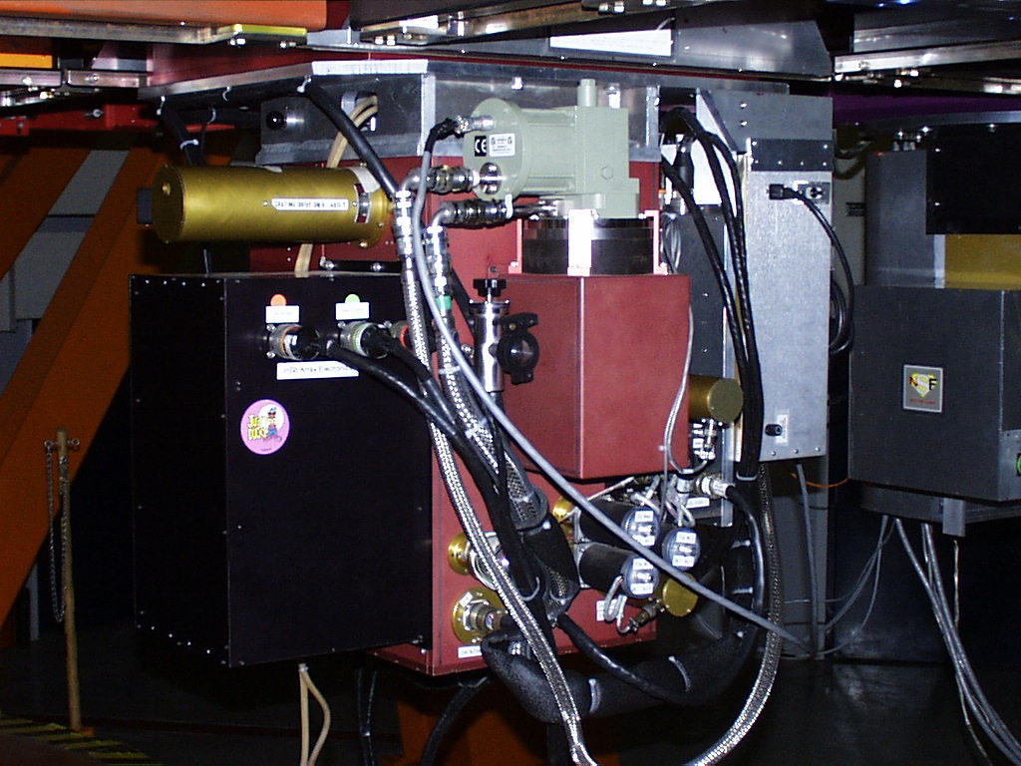
CSHELL
Spectrograph
Capability to take
spectra from
1 μm to 5.5 μm
(near-infrared)
My data ran from
2.163 μm – 2.169 μm
Resolution 25,000

Slide 6
Data Reduction
Raw data

Slide 7
Data Reduction
Spectra after reduction. Each panel has the spectra of the Primary and Secondary stars.

Slide 8
Analysis

Slide 9
Analysis

Slide 10
Analysis

Slide 11
Conclusions
There are five stars present in the data set that are strong candidates for planet forming regions.
All of these five stars have a Brγ emission line ≥ 2 Å as well as a K-L color excess ≥ 0.4
Four of the five stars are in two binary systems, with the fifth star is the secondary of another system.

